Slide 1
Introduction to Image Analysis with FIJI
Segmentation and Classic Image Analysis Pipeline
Gayathri Nadar
Image Analyst, Cellular Imaging Facility
FMP-Berlin
Topics:
Segmentation introduction
Classic segmentation pipeline
With material from:
Christopher Schmied (Former CIF)
Noreen Walker (former MPI-CBG)
Robert Haase (PoL, Dresden)

Slide 2
Program
Part 1
Introduction to Images
Basics of FIJI
Manual measurements
Detecting Objects: Counting Objects
Part 2
Detecting Objects: Segmentation
Classic Segmentation Pipeline with Quantification

Slide 3
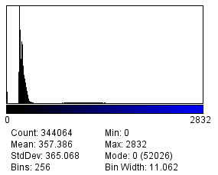
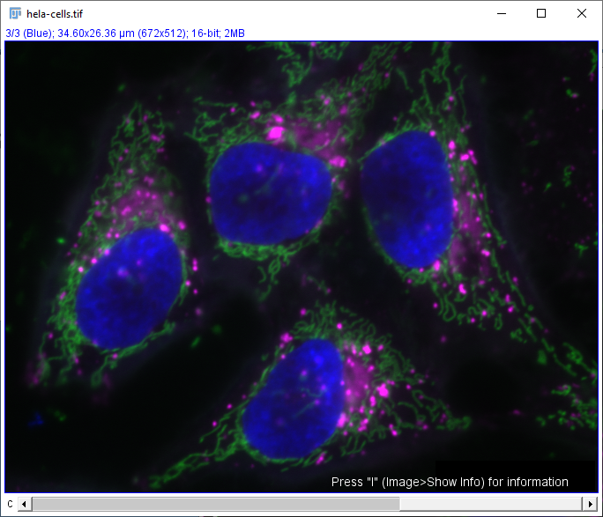
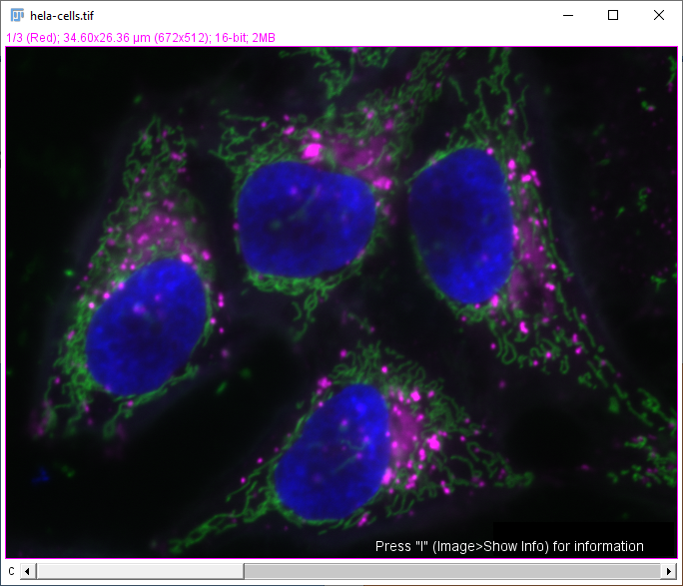
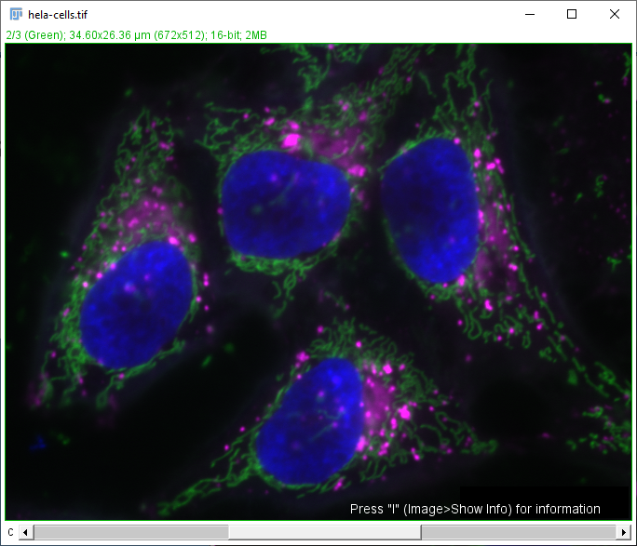
Quiz (1/2)
This histogram shows the grey value distribution of which image?

Slide 4
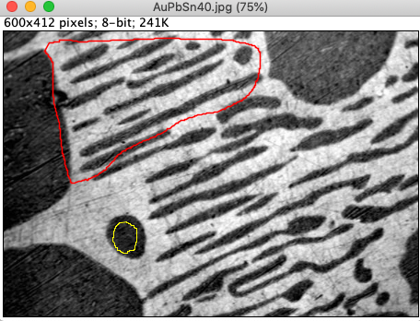
Quiz (2/2)
You have an image with an overlay in red and a Roi selection in yellow.
When you press the key M (measure), which region will be measured?
Overlay
Full image
Roi

Slide 5
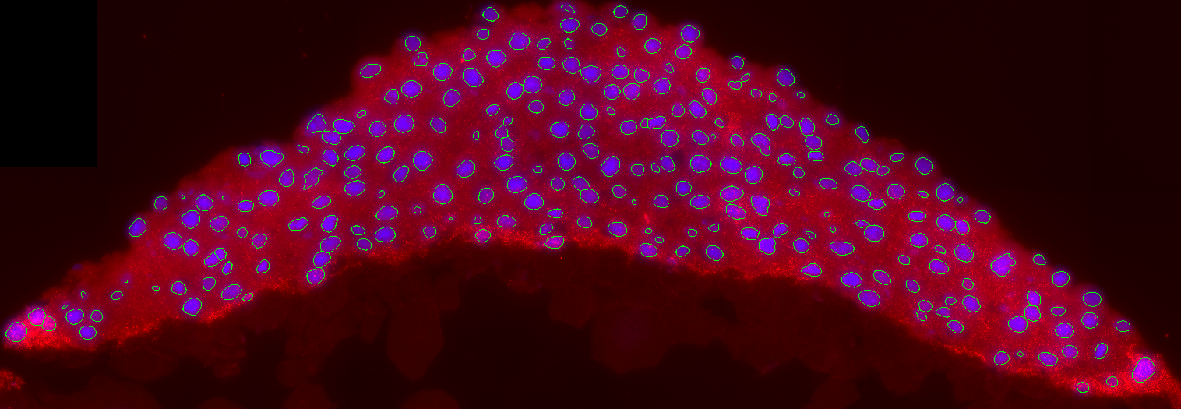
Segmentation

Slide 6
Part 2: Overview
Segmentation introduction
Classic segmentation pipeline
Preprocessing, thresholding, post-processing
Particle analysis and measurements
Other tools/methods
Further resources

Slide 7
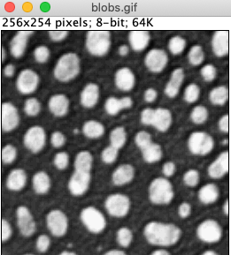
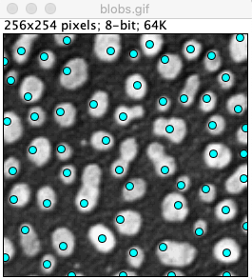
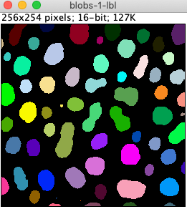
Finding Objects
Object detection
Point/Box per object
Use cases:
Counting
Tracking spots
Object segmentation
Outline per object
Uses cases:
Shape quantification
Spatial relation of objects
Notes:
Detection is easier
Spatial relation between objects: e.g. neighbors, what is inside/outside of cells

Slide 8
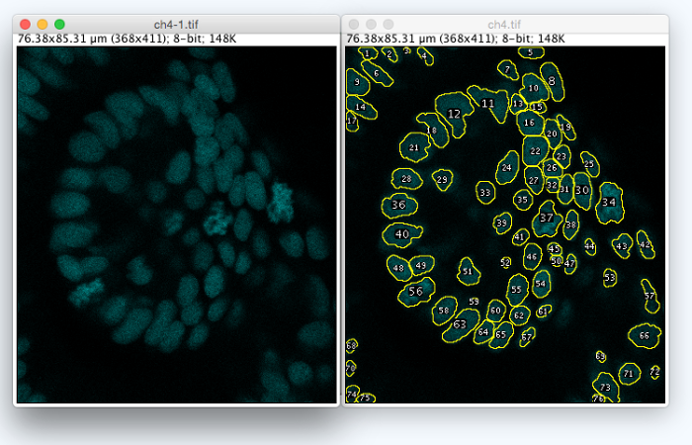
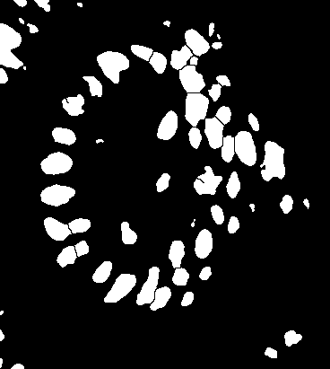
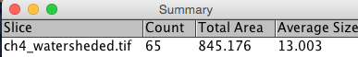
Goal
Determine the cell regions (objects) automatically and measure their properties.
Image Source: Jaydeep Sidhaye, Norden Group, MPI CBG

Slide 9
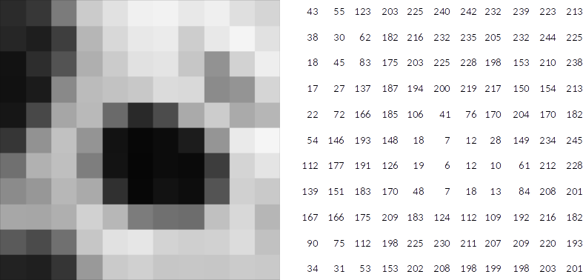
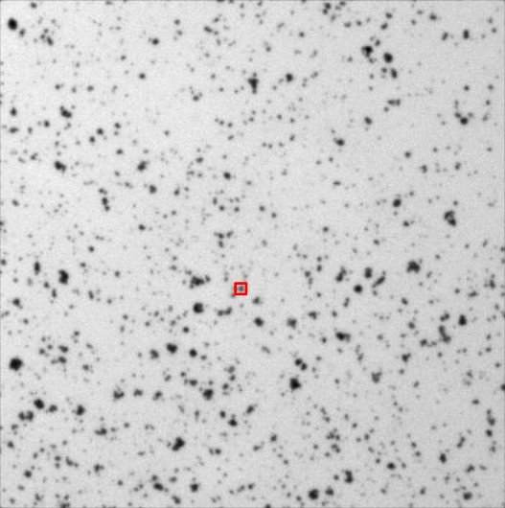
Splitting an image into regions
Objects in images have common grey values that are connected

Slide 10
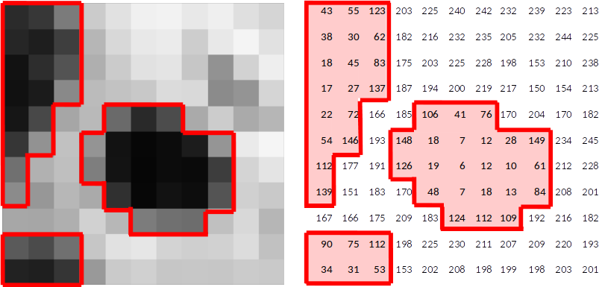
Splitting an image into regions
Objects in images have common grey values that are connected
Segmentation: Separate objects in the foreground from unwanted background

Slide 11
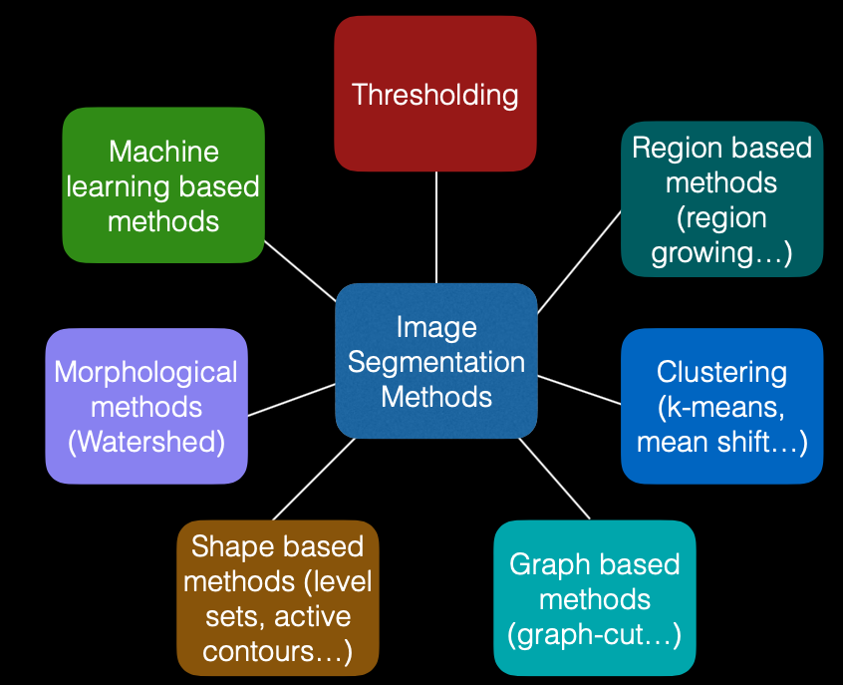
How to split an image into regions?
Many methods for segmentation exist.
Image by: Ignacio Arganda-Carreras, Biological Image Reconstruction and Analysis Course, 2016

Slide 12
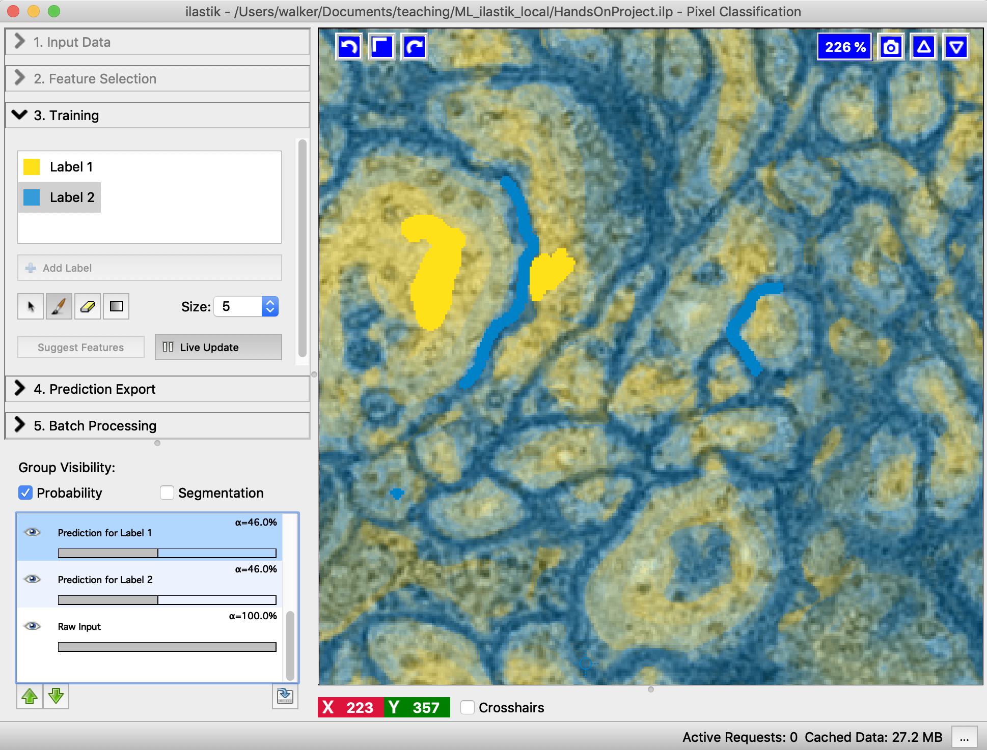
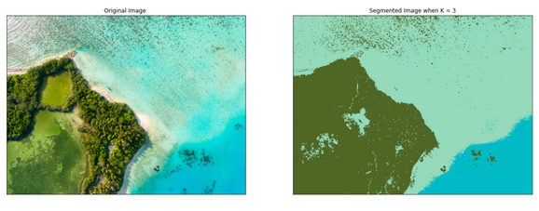
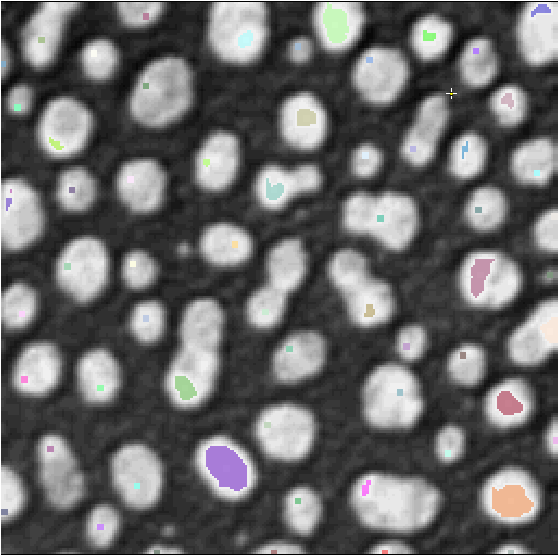
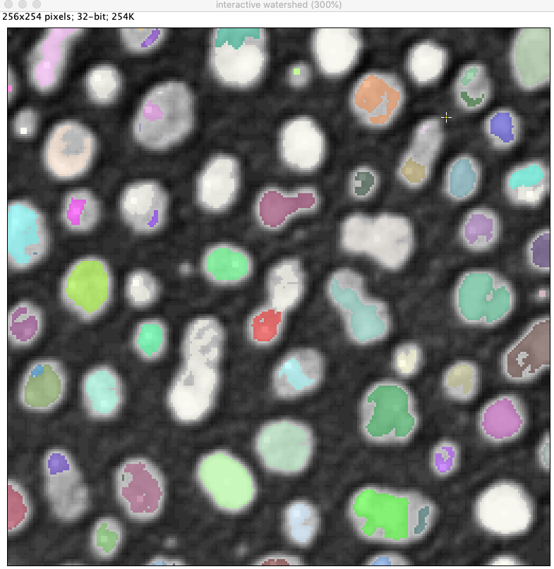
How to split an image into regions?
Examples
Thresholding
Machine learning: supervised pixel classification
Unsupervised learning: Clustering
Region growing: from seed points
Image: https://morioh.com/p/dcdc9957bc1c
Notes:
Thresholding: simple but often works
Pixel classification: also quite simple to do.

Slide 13
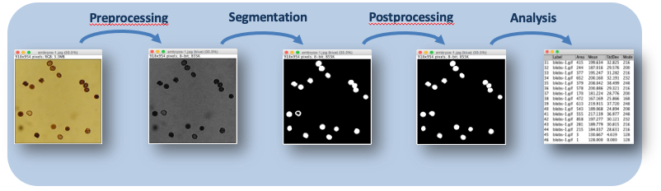
Classic segmentation pipeline

Slide 14
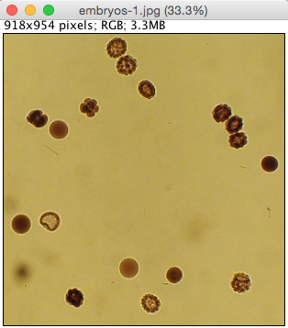
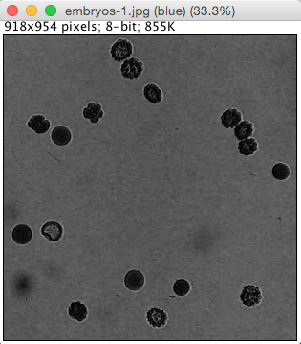
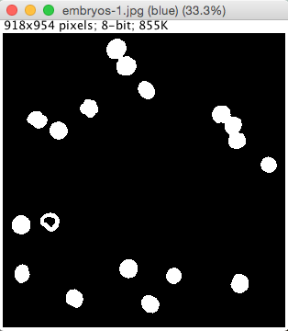
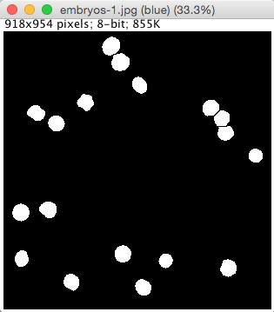
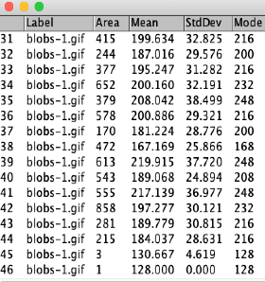
Typical pipeline
Pre-processing
Segmentation
Post-processing
Analysis
Preprocessing
Deconvolution
Denoising/ Smoothing
Data reduction
Background correction
….
Segmentation
Thresholding
Pixel classifiers (machine learning)
Region growing
Edge based segmentation
…
Postprocessing
Morphological operations:
Watershed
Fill holes
Opening/Closing,…
…
Analysis
Counting
Measure properties
…

Slide 15
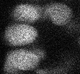
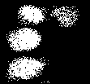


Preprocessing: Denoising
Reduce the effects of noise using Gaussian Blur
In Fiji:
Process > Filters > Gaussian blur
Or:
Process > Smooth
Thresholding
Oh no! I see thousands of white objects!
Blurring
Thresholding
Ok, it’s just 4 objects.

Slide 16
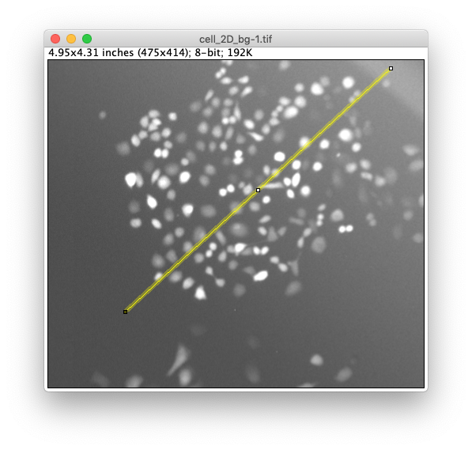
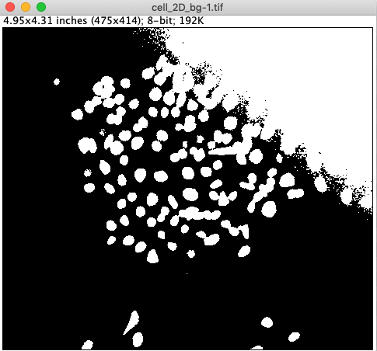
Preprocessing: Subtract Background
If the background is uneven, objects can be hard to segment.

Slide 17
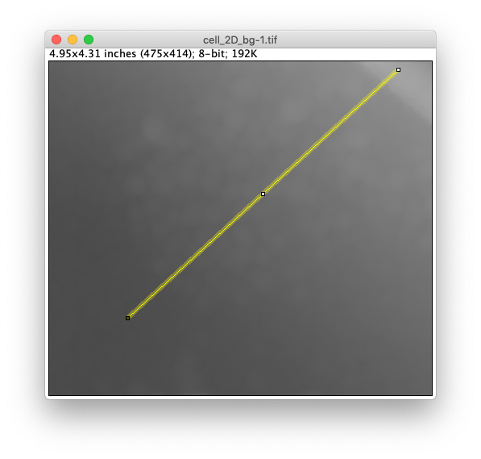
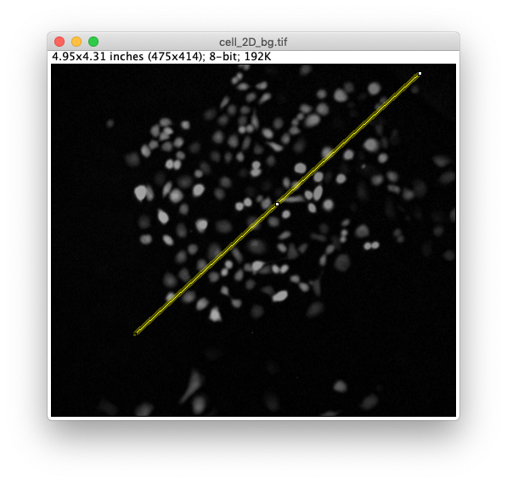
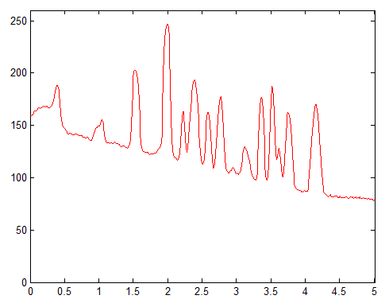
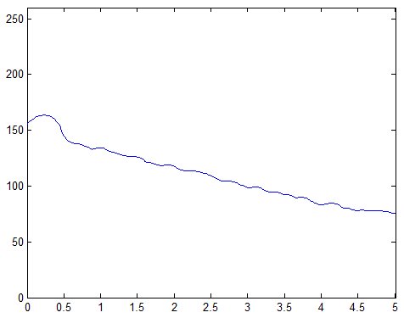
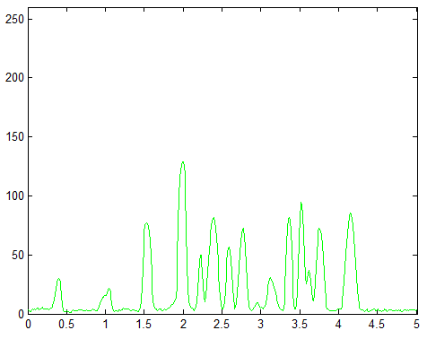
Preprocessing: Subtract Background
If the background is uneven, objects can be hard to segment.
Remove flatfield in the background.

Slide 18
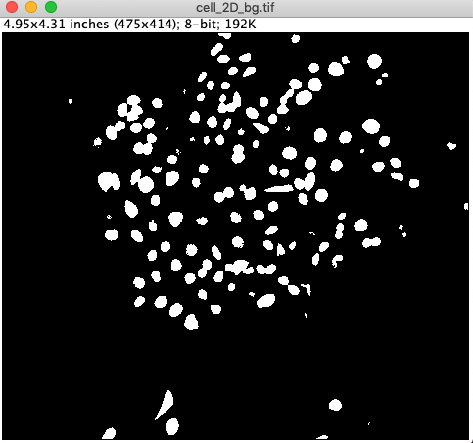
Preprocessing: Subtract Background
If the background is uneven, objects can be hard to segment.
Remove flatfield in the background.

Slide 19
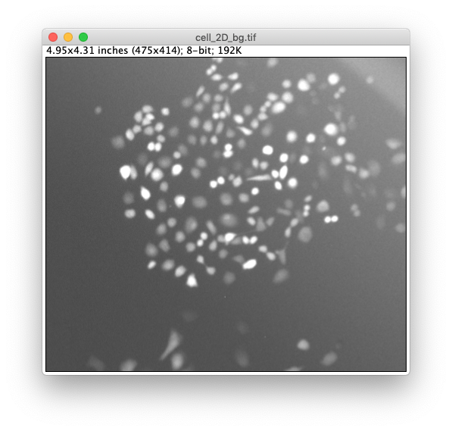
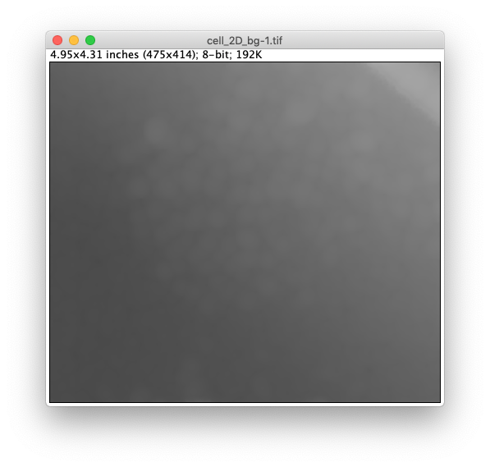
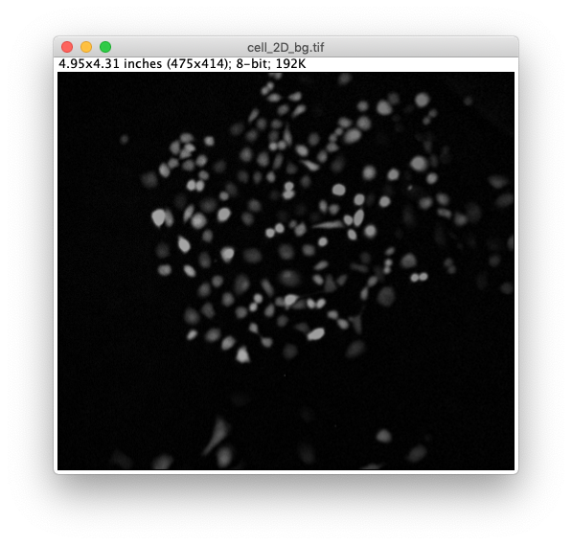
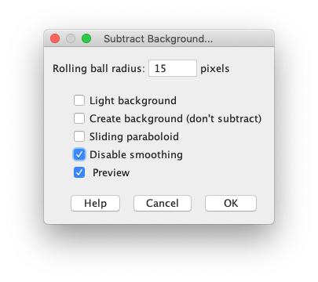
Subtract Background in Fiji
In Fiji:
Process > Subtract Background …
> radius of largest object to be detected

Slide 20
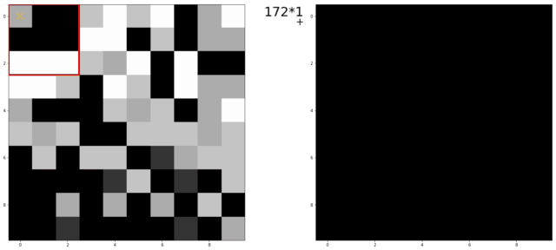
Extra: Spatial Filters
An image processing filter is an operation on an image.
Filters change pixel values: linear combination or non-linear function of surrounding pixels
Linear: Gaussian blur, Mean
Non-linear: Median, Min, Max
Application examples
Noise-reduction
Artefact-removal
Contrast enhancement
Correct uneven illumination
Blurring, background subtraction are all filtering operations
Linear filter in operation
75 | 85 | 60
67 | 73 | 91
50 | 88 | 59
Non-Linear
filter
[ 50 59 60 67 73 75 85 88 91 ]
Min
Median
Max
1/16 | 1/8 | 1/16
1/8 | 1/4 | 1/8
1/16 | 1/8 | 1/16
Gaussian filter, 3x3 kernel
(linear)
In Fiji:
Process > Filters > …
Animation source: Dominic Waithe, Oxford University
https://github.com/dwaithe/generalMacros/tree/master/convolution_ani
Notes:
Optional background information on image filters.

Slide 21
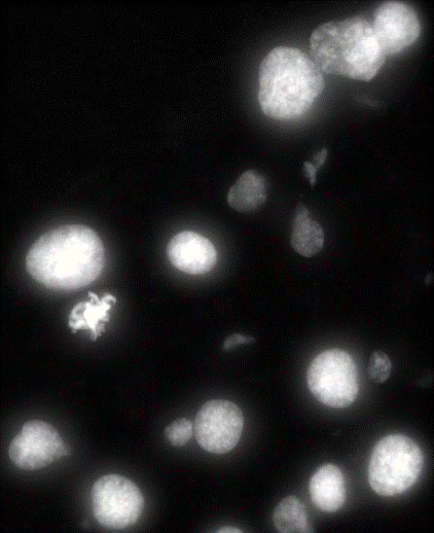
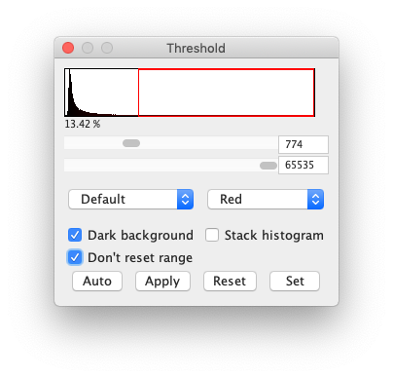
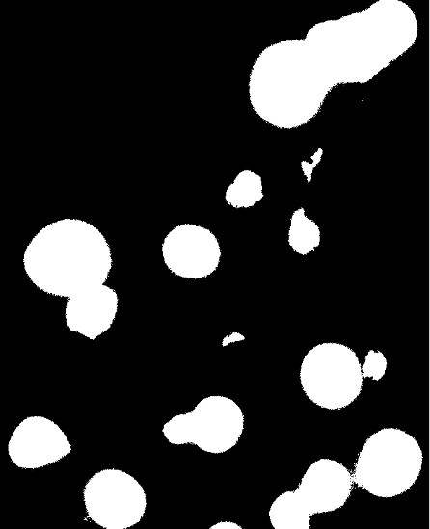
Thresholding
Thresholding is used to create a mask of foreground objects in an image.
It is the simplest form of segmentation.
In FIJI menu, Image > Adjust > Threshold or Cmd/Ctrl + shift + T
Always use an automatic method for threshold selection
-> reproducibility.
Apply creates a mask.
Switching dark background inverts the selection.

Slide 22
Demo/Hands-on
Goal: Importance of preprocessing before thresholding
Remember: Garbage in, garbage out!
Activity: Threshold image cell_2D_bg.tif with and without background subtraction

Slide 23
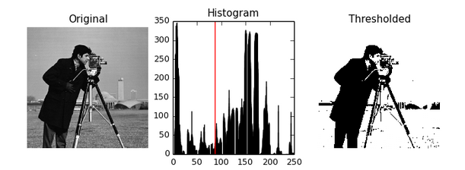
Thresholding Methods
Automatic thresholding methods compute the threshold based on the image histogram.
Otsu method:
Maximize the variance between the two classes of pixels, which are separated by the threshold.
Equivalent: Minimize the variance with each class.
-> Works well for bimodal distributions.
https://scikit-image.org/docs/0.10.x/auto_examples/plot_otsu.html

Slide 24
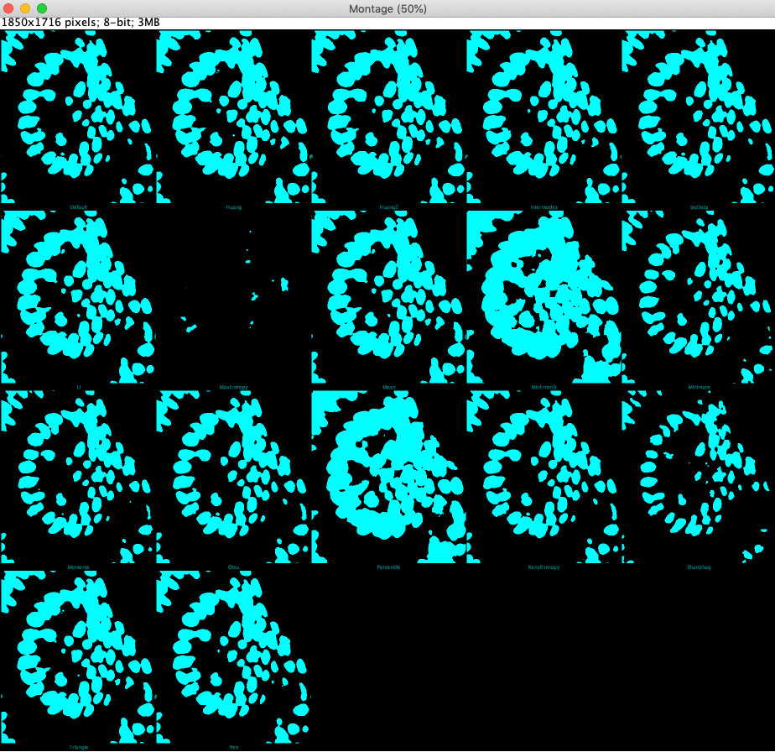
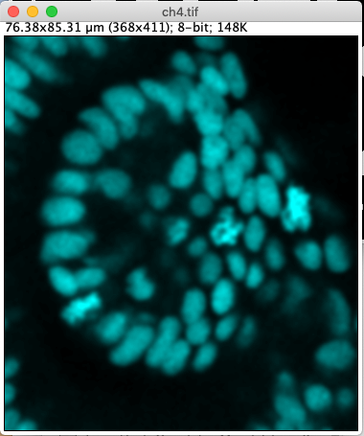
Choosing the thresholding method
It is easy to compare all automatic thresholding methods in Fiji.
In FIJI, Image > Adjust > Auto threshold with try all checked.
Before picking your method, test it on a few of your images.
Montage
of outputs
Side note: Local thresholding:
This is a method where the threshold value is not global but changes locally.
The threshold at each pixel is computed based on the intensity in its local surrounding.
Image > Adjust > Auto local threshold: Compare methods.

Slide 25
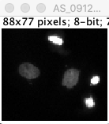
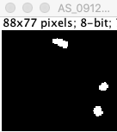
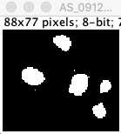
Quiz
We have applied two thresholding methods on the image on right and the results are below.
Which method/solution do you think is better?
Input
A
B

Slide 26

Post-processing: Mask cleanup
Process > Binary > Fill holes
Process > Binary > Watershed (split objects)
Process > Binary > Open [then] Close (remove small objects)

Slide 27

Extra: Morphological operations
Morphological operations are image filters which are used on binary masks.
Useful for mask clean-up after thresholding
Some of the morphological operations:
In Fiji:
Process > Binary > …
Erosion
Dilation
Opening: Erosion > Dilation
Closing: Dilation > Erosion
Watershed
Fill holes
Dilation
Erosion
Animation: https://www.edx.org/course/image-processing-and-analysis-for-life-scientists
Notes:
Optional background information on morphological filters.
Opening: Erosion followed by dilation
Closing: Dilation followed by erosion

Slide 28




Post-processing: Binary Watershed
Watershed
Split touching objects.
Model: Objects are roundish and touch at a “thin neck”.

Slide 29



Binary Watershed
The watershed algorithm for binary images allows cutting one object into two where it’s reasonable.
Binary segmentation
Distance map
Slide courtesy: Robert Haase

Slide 30


Binary Watershed
The watershed algorithm for binary images allows cutting one object into two where it’s reasonable.
The watersheds are made from binary images. The algorithm does not take the original image into account!
Binary segmentation
Distance map
Watershed
Original image
Slide courtesy: Robert Haase

Slide 31


How many regions do we have?
Connected component labelling
Naming conventions
Mask or Binary image or Thresholded image
Foreground (255) vs Background (0)
Label image
Each region has a unique value (background=0, cell1=1, cell2=2, etc.)
Different algorithms expect different input.

Slide 32



Fiji: Set Measurements
Set the measurements before doing particle analysis.
In FIJI, Analyze -> Set Measurements
Includes option to redirect a measurement
…but take measurements (intensity etc) from this image.
Analyse these particles…

Slide 33




Fiji: Particle Analyzer
Fiji: Analyze > Analyze Particles …
?

Slide 34

Optimizing the Segmentation Pipeline
Pre-processing
Segmentation / Regionalisation
Post-processing / correction
Measurement
Results not good?
Change analysis parameters
Change imaging settings
Notes:
Recap of the pipeline

Slide 35


Add-on: ROI versus Mask (Fiji)
ROIs and Masks in Fiji can be converted into each other.
Edit > Selection > Create Selection
Edit > Selection > Restore Selection
Edit > Selection > Create Mask

Slide 36



Add-on: Selection
ROI selections can also be inverted to select the background.
Edit > Selection > Create Selection
Edit > Selection > Restore Selection
Edit > Selection > Make inverse

Slide 37







Add-on: MorphoLibJ (Fiji)
A great library for segmentation and post-processing.
Well documented! (https://imagej.net/MorphoLibJ)
Subscribe to the update site: Help > Update…> Manage Update Sites. Add IJPB-plugins
Some useful tools for post-processing:
Keep largest region
Remove small regions

Slide 38
Demo: Segmentation
Data obtained from Elnaz Fazeli, University of Turku

Slide 39

Exercise: Segmentation
Segment cells, measure each cell brightness, and get cell count. (Cell_2D_bg.tif)
Duplicate image and work on it
Preprocess with gaussian blur
Subtract background
Duplicate this image to re-use for measurements.
Threshold
Optional: Open/Close, Watershed
Set measurements (Don’t forget to redirect)
Analyze particles
Tips:
Use the search bar (key L) if you don’t find a command.
Duplicate your image regularly as backup (Cmd/Ctrl + Shift + D) ☺
Use the ‘Preview’ buttons
More datasets to segment:
cell_chain.png, cell_colony.tif, AS_09125_050116000001_L15f00d0_slice1_channel1.tif (use Binary > Open or MorpholibJ to remove small regions)

Slide 40




Summary
Region segmentation
Watershed: split regions
Binary image
Labels
Classic segmentation pipeline
Pre-processing
Segmentation
Post-processing
Analysis

Slide 41


Other Segmentation Methods/Tools
Segmentation with thresholding is a simple pipeline and often works.
Recall that also many segmentation methods/ tools exist.
Example tools:
Ilastik: https://www.ilastik.org/ , Weka (FIJI)
Pixel classification with (shallow) Machine Learning
Step-by-step: link below
StarDist, CellPose
Deep Learning (Neural nets)
Very powerful
Cell Profiler: https://cellprofiler.org/
Hierarchical object segmentation (e.g. cells + spots inside)
Many example pipelines available
https://cellprofiler.org/examples
Ilastik GUI
Cell profiler GUI
https://mpicbg-scicomp.github.io/ipf_howtoguides/guides/Ilastik_PixelClassification.html
Notes:
From simple to more complex methods

Slide 42



Advanced segmentation: StarDist
“StarDist”
a neural net for segmenting roundish, dense objects (like droplets, nuclei)
Pretrained net available as Fiji plugin (2D, 2D+t):
Plugins > StarDist > StarDist 2D
https://imagej.net/StarDist
Tips:
Read the documentation
Nuclei appearance and size should be similar to training data (~20px)
For 3D: use python
Notes:
Why doc? Powerful tool but important to know what it’s been intended for

Slide 43

Exercise: StarDist 2D
Segment cells with StarDist in Fiji.
Open image SegmentationTestImage_crop-ch4.tif.
Now launch StarDist: Plugins > StarDist > StarDist 2D
Restore Defaults > OK
Visualize the ROIs from ROI Manager on the image.
OPTIONAL
Try to get a mask of the cells using our classic pipeline (Gaussian Blur, Thresholding).
Which was easy – previous or this?

Slide 44
Further Resources

Slide 45


Image.sc Forum: Getting Help
https://forum.image.sc/
Very active forum on image analysis
For all user levels
For conceptual questions, technical issues, announcements etc.
Often you get help very quickly.
Tips:
Be nice – the people who help you are volunteering.
If you know an answer: help others.

Slide 46


Image Visualization Cheat Sheet
By: Christopher Schmied, Helena Jambor
Paper & download: https://f1000research.com/articles/9-1373

Slide 47

Resources
User Forum:
Use https://forum.image.sc/ to interact with the broader community, asking questions, finding solutions, etc.
Strongly recommended!
Courses and text books:
NEUBIAS training: http://eubias.org/NEUBIAS/training-schools/
EMBL: https://www.embl.de/training/events/index.php
Book by Kota Miura: https://www.researchgate.net/publication/297738620_Bioimage_Data_Analysis
Interactive textbook by Pete Bankhead: https://bioimagebook.github.io/README.html
How-to Guides:
From SCF-MPI-CBG: https://mpicbg-scicomp.github.io/ipf_howtoguides/
From Uni of Zurich: https://zmb.dozuki.com/c/Image_Analysis#main
Video lectures
EPFL: image processing and analysis for Life Scientists: https://www.edx.org/course/image-processing-and-analysis-for-life-scientists
Robert Haase: Lecture BioImage Analysis (Dresden): https://www.youtube.com/playlist?list=PL5ESQNfM5lc7SAMstEu082ivW4BDMvd0U
NEUBIAS Academy @Home: https://www.youtube.com/c/NEUBIAS/featured http://eubias.org/NEUBIAS/training-schools/neubias-academy-home/
ImageJ Documentation:
ImageJ user guide: https://imagej.nih.gov/ij/index.html

Slide 48

Image analysis – further reading
https://imagej.net/User_Guides

Slide 49
We did it! Thank you for joining!
🏆
Lastly, we‘d love to get your feedback!

